Slide 1
Business Forum
April 9, 2019
HRTC 141-45

Slide 2
Agenda
Post Awards and Grants Partner Group
Compensation Partner Group
Hospitality Partner Group
Key Announcements

Slide 3
Post Awards and Grants Partner Group
Luanne Bowman, Russ College of Engineering and Technology
Cindy Perry, Grants Accounting
Co-chairs:

Slide 4
Post Awards and Grants Partner Group
Charge
The Post Awards & Grants Partner Group is charged with developing solutions to issues that impact the application, implementation and accounting for external awards.

Slide 5
Post Awards and Grants Partner Group
Representation
  Wendy Kaaz, College of Arts and Sciences
  Beth Tragert, College of Health Sciences and Professions
  Greg Jolley, Heritage College of Osteopathic Medicine
  Melissa Standley, Heritage College of Osteopathic Medicine
  Chip Rice, Patton College of Education
  Shannon Bruce, Russ College of Engineering and Technology
  Mike Finney, Voinovich School
  Mo Valentine, Office of Research and Sponsored Programs
  Keith Leffler, Vice President for Research

Slide 6
Post Awards and Grants Partner Group
Goals
Roles & Responsibilities matrix – policies and procedures review
Grants Management Training
Institutional Base Salary – define and how impacts campus
Vacation & Sick leave
Other issues that arise
  Cost share process
  Terminology definitions

Slide 7
Roles and Responsibilities Matrix
Steps
Identify the owner and contributors for each function (complete)
Identify the appropriate level of internal control for each function (complete)
  Regulatory
  Institutional Policy
  Procedure
  Instruction
Perform GAP analysis to identify where internal controls are ineffective (in progress)
Create policies, procedures, instructions, and training where needed (not started)
Create website portal (not started)

Slide 8
Roles and Responsibilities Matrix
Functions:
Identification of Funding Opportunities
Proposal Preparation and Submission
Pre-Award/Post-Submission
Regulatory Compliance
Award Negotiation, Acceptance, and Account Establishment
Managing the Award – Financial
Managing the Award - Non-Financial
Financial Reporting
Closing Out the Award

Slide 9
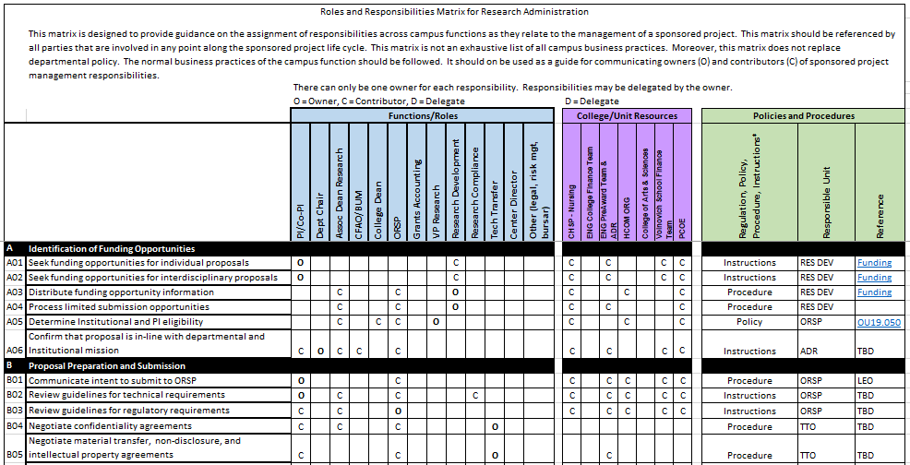
Roles and Responsibilities Matrix
Draft Function, Roles, Policy and Procedures

Slide 10
Grants Management Training
National Council University Research Administrators webinars
  Office of Research and Sponsored Programs notifies by email. Send request to orsp@ohio.edu to be put on list.
    NIH Fundamentals
    OIG Audits
    How To Deal with HIPAA Rules
Grants Accounting Fundamentals – scheduled Fall and Spring Semesters – next training 4/25/19
Cost Share – online training in development

Slide 11
Institutional Base Salary Policy
Defined
The purpose of this policy is to establish Ohio university’s definition of “Institutional Base Salary” (IBS) for the purposes of sponsored projects. The federal government requires that recipients of federal funding establish an institutional policy that documents the basis for all budgeting and expensing of salaries on sponsored projects and requires that all such costs be treated consistently regardless of the source of funds.
  https://www.ohio.edu/policy/41-005

Slide 12
Continued Projects
Vacation and Sick Leave accruals and payouts
Cost share process for Sponsored Awards
Defining some of the terminology that we use:
  Restricted vs Unrestricted
  Exchange vs Non-exchange
  Sponsored vs Service

Slide 13
Questions?
Are there post award, grant, sponsored research issues that the broader University community would like to see on this group’s agenda?
Luanne Bowman, bowmanl3@ohio.edu
Cindy Perry, perryc@ohio.edu

Slide 14
Compensation Partner Group
Co-chairs:
Megan Vogel, Special Assistant to the Vice President for Student Affairs/Director of Resource Administration
Kelly Coakley, Manager of Compensation

Slide 15
Compensation Partner Group Partner Group Charge
The Compensation Partner Group is charged with reviewing existing policies and developing new policies and/or procedures regarding compensation of employees at Ohio University.

Slide 16
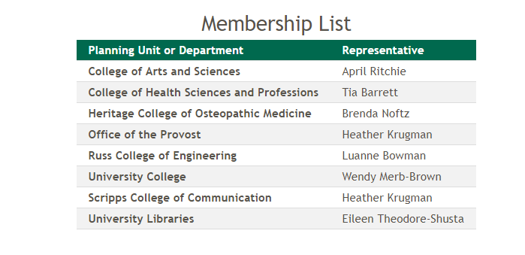
Compensation Partner Group Representation

Slide 17
Compensation Partner Group Partner Group Goals
Review and refine Reappointment process​
Review and suggest compensation content in conjunction with UHR Compensation for new HR website​
Suggest revisions and updates to job description template and supporting documentation

Slide 18
FY20 Reappointment
Raise Pool – July 2019
1% merit based raise pool for Faculty and Administrators
1% across the board increase for Classified Non-Bargaining Unit employees
1.5% Increase for FOP and AFSCME pursuant to the collective bargaining agreements
Must be an OHIO employee before April 1, 2019 to be eligible

Slide 19
FY20 Reappointment
Potential Raise Pool – January 2020
There is a potential for an additional, contingent raise pool of 0.5% effective January 1, 2020. The awarding of this raise pool to Administrative, Faculty, and Classified Non-Bargaining unit employees will be contingent on financial performance metrics that will be defined and communicated when the budget is finalized.
Must be an OHIO employee before April 1, 2019 to be eligible

Slide 20
FY20 Reappointment
Timeline
2/15/19: Control total snapshot taken
3/22/19 – 3/27/19: Control total files sent to CFAOs
5/1/19: Additional Salary and Fiscal Increments open in ICD
Reappointment files sent to CFAOs
5/31/19: Completed reappointment files due to Compensation
6/23/19: Annual increases effective for biweekly employees
7/1/19: Annual increases effective for semi-monthly employees

Slide 21
Pay Administration Guidelines
Changes/Clarifications - Effective 4/1/19
Hiring of an external candidate: Hiring managers may hire external candidates at a rate up to the 25th percentile of the pay grade, provided knowledge, skills and experience warrant that placement. Offers above the 25th percentile are not permitted unless a compa ratio analysis and equity review is performed by Compensation prior to the offer being made to the applicant.
Hiring of an internal candidate, resulting in a promotion/ movement into a higher pay grade: Hiring managers may offer internal candidates a 5-15% increase total in pay for a promotion, with the percentage increase based on documented performance in their former role and equity placement in the new job, or to the minimum of the new pay grade, whichever is greater
Hiring of an internal candidate, resulting in a lateral move/no change in pay grade: There is to be no change in pay for a lateral move.

Slide 22
Pay Administration Guidelines
Changes/Clarifications - Effective 4/1/19
Hiring of an internal candidate, resulting in a demotion/movement into a lower pay grade: Hiring managers must offer internal candidates a 5-15% decrease in pay, or no greater than the maximum of the new pay grade for a demotion, (with the percentage decrease based on documented performance in their former role and equity placement in the new job).
Incumbent Reviews: Position descriptions are reviewed once a year by departments and employees during the performance management process. Positions that have changed more than 30% should be submitted to Compensation for review. Classified Non-Bargaining Unit employees can request a position review by Compensation through their manager. Jobs cannot be reviewed for reclassification more than once per year. Jobs cannot be reviewed for reclassification if the incumbent has been in the job less than 6 months. Changes to a position that result in a promotion, demotion, or lateral move for an employee will follow the same pay practices previously mentioned.
Counter Offer: Counter offers may be considered for employees with a current, regular appointment, when the employee can produce verifiable documented evidence of an external offer of employment for a similar role. Counter offer requests must be approved by Compensation and the Dean/Vice President prior to the counter offer being communicated to the employee. When a counter offer has been offered and accepted, Ohio University will not consider future counter offers in the same capacity to which the employee currently serves. Counter offers are prohibited for internal offers within Ohio University. Bonuses or Employee Recognition Awards may not be used for this purpose.

Slide 23
Questions
compensation@ohio.edu

Slide 24
Hospitality Partner Group
Wendy Merb-Brown, Assistant Dean for Operations and First Year and Student Transitions, University College
Gwyn Scott, Associate Vice President for Auxiliaries
Co-chairs:

Slide 25
Issue | Visitor Friendly Campus | Centralized information center | Centralized Space Scheduling and Access to spaces
Context | Wayfinding, parking and welcoming signage (i.e. where are restrooms, ADA, etc.: challenges of navigating campus) | A go to place for events, or information on what is happening on campus | Multiple scheduling systems, go to people not system, ownership of space issues
Ideas/ Projects | Update Wayfinding for event friendly and campus access Customer friendly Access to permits (particularly guests) Welcome Center! | Academic Engagement Center Reprogram Bingham Provide space within Baker Online access tool (scheduling) Calendar of events | Central System Review space ownership
Progress | Transportation Services is working on replacing signs. | AEC is funded and work is in progress. | University advancing space utilization study which will hit this in integration with other space dependencies
Advocate | Transportation Services, University Planning, Admissions, OUPD | University Planning, Event Services | University Planning & Real Estate
Challenges | Prioritization of resources | Communication concern | Resources and communication, technical support.

Slide 26
Issue | Event planning/people, processes | Products/value vs. costs – communicating clearly | Lack of Brand, Mission Outreach
Context | Many people on campus have “event” responsibilities, not all are as knowledgeable of resources/processes | What are the appropriate costs for our services (hospitality-related)? | There isn’t a clear “Bobcat” brand, or Ohio brand
Ideas/ Projects | Identify staff with hospitality roles Regular meetings with group to share knowledge Collecting resources Professional Development/badging opportunity Manual/FAQ (online?) | Units create price points for services (staffing, products, depreciation, replacement costs) Sharing cost break-downs between units | Identify what “OHIO” is and communicating to the campus. Opportunity for feedback from visitors
Progress | Event Services is beginning this work | Many units on campus already have determined pricing structures. | Consultant hired by UCM to address this. Communication has been moved to VP, will be identified soon.
Advocate | Event Services, Risk Management (Facilities) | Facilities Management, Culinary, Transportation, Event Services | University Communication and Marketing
Challenges | Communication, lack of “lead” on project. | Lead on project | Resources and lack of knowledge

Slide 27
Questions

Slide 28
Finance Updates
Julie Allison, Associate Vice President, Finance

Slide 29
Agenda
Travel
Year-end Close
PO Close Process
Cleanup Overspent Accounts (PTA)
Effort Reporting
Finance Trainings

Slide 30
Travel Update
Christopherson Business Travel – LIVE Monday, April 1
No major issues to date
Working to direct people to resources available
  Website – www.ohio.edu/travel
  Training – courses available through Professional Development Program
    Booking Individual Travel
    Travel Policy and Procedures
    Concur Expense Reporting
  Onsite Travel Manager: Sedrick Ratchford

Slide 31
Info Sessions & Open Labs
Info Sessions: 110 attendance to date
  2 Session on April 9 in Baker & AdobeConnect
  3 Session on April 10 in Baker
  Register for Travel Info Session
Open Labs: 2.5 hours per day in WUSOC 175
  Register for Open Lab

Slide 32
Questions?
Visit www.ohio.edu/travel
  Individual and Group Procedures
  FAQs
  CBT Contact and Fee structure
  Quick Reference Guides
For training courses visit
  www.ohio.edu/hr/professional-development

Slide 33
Important Campus Year-End Close Dates for FY19
Date | Time | Item Due
July 8, 2019 | 5:00 p.m. | All Final FY19 Internal Billing Authorizations due (uploaded via JET*) Final FY19 Capital Project Funding Transfers due to CPF@ohio.edu
July 17, 2019 | 5:00 p.m. | FY19 Concur reports due - submitted to Financial approver (for trans date of 6/30 or before)
July 24, 2019 | 8:00 a.m. | Final FY19 Payroll Accounting Corrections due to Payroll for all GL accounts
July 24, 2019 | 5:00 p.m. | FY19 Concur reports due - approved by Financial approver (for trans date of 6/30 or before)
July 25, 2019 | 5:00 p.m. | All PO Invoices for FY19 are due to accounts.payable@ohio.edu All Payment Requests must be submitted and approved by Financial Approver
July 29, 2019 | 5:00 p.m. | Final FY19 Grants Module Payroll Accounting Corrections due to Grants Accounting for all PTA accounts
July 30, 2019 | 4:00 p.m. | Final FY19 Accounting Corrections due (uploaded via JET*)
*JET (Journal Entry Template) is a new tool expected to roll out in May 2019 – more information will be released in April

Slide 34
Year-end Close Dates for FY19
1st Close: Tuesday, July 9, 2019
2nd Close: Wednesday, July 31, 2019
3rd Close: Friday, August 9, 2019

Slide 35
Purchasing – Year-End Close Prep
PO Closures
  Service Agreements carry over fiscal years (PO’s will not be closed)
  Blankets will close August 2
  May need change orders for FY19 expenditures – quick turnaround to get processed for FY19
  Automatic Closure by Purchasing
    POs 60 days or older that are fully matched +/- $5.00
    Only closed POs, will be finally closed after 120 days
  To release encumbrances, submit PO closure request only after all invoices have been paid, including freight

Slide 36
Purchasing – Year-End Close Prep
Contract Extension
  Contracts expiring June 30, 2019 with optional extensions available
  Deadline is May 1
  If total expected spend of contract is >$500,000 need a contract routing form
Large Equipment or Vehicles
  Purchases over $50,000 that require a Request for Quote (RFQ)
  Deadline is May 6
  Purchase must be received by June 30 to use FY19 funds (otherwise will be billed to FY20)

Slide 37
Prepaid Invoices Year-end Information
If you receive goods or services after Sunday, June 30, 2019 but:
  The invoice is paid in FY19 and the amount is greater than $10,000; or
  The invoice is paid in FY19 because a deposit was due for the goods or services split between fiscal years and the calculated amount in the wrong fiscal year is greater than $10,000
Please contact Kris Sano at sanok@ohio.edu to discuss the possible prepaid entries needed.

Slide 38
Functions on Graduate Appointments
Departments are responsible for reviewing all functions that are assigned to their Graduate Appointments (GA) through the OGA system (visible, after the fact, in OBI Finance dashboards)
Contact your CFAO if you need assistance determining the correct function for your department
  The following resources can be utilized as a reference when you are uncertain of the correct function
    COA Fundamental Training
    COA-Function Segment Quick Reference Guide
Example:
  If a GA is working in an administrative role in an instructional department, their service stipend and their associated tuition scholarship, should both be coded as an Instructional function (10)
  Avoid coding everything to Academic Support (40) unless it is truly Academic Support (last resort)
Please contact Kris Sano sanok@ohio.edu if you have a large number of past appointments for FY19 that need to be corrected.

Slide 39
Grants Accounting Overspent Balances
Accounts maintained in Grants Accounting module (Internal, Sponsored and Cost Share Awards) cannot be overspent and must be closed out timely
  Accounts reviewed on a monthly basis to correct overspent balances
  Accounting corrections submitted timely (60 day accounting correction rule)
  Accounts must meet all fiscal year end timelines (may mean making adjustments prior to 60 day rule)
Departments highly encouraged to use Grants Funds Available in OBI to view overspent accounts (sort based on Overspent prompt)

Slide 40
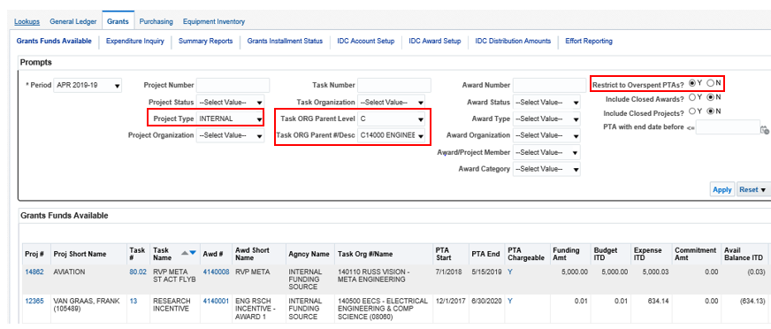
Example Overspent Prompt
Restrict to Overspent PTAs? Y
Include Closed Awards? N and Include Closed Projects? N
Project Type: Internal
Task ORG Parent Level and #Desc: Level C and Planning Unit

Slide 41
Effort Reporting Update
Ohio University’s reporting periods for effort certification are:
  Fall Semester August 16 – December 31
  Spring Semester January 1 – May 15
  Summer Semester May 16 – August 15
Fall FY2019 Effort Certification was sent to departments on April 5, 2019
  Effort Certification due to Grants Accounting Office no later than 5 PM on Friday, April 19, 2019
  Auditors for fiscal year end audit select certifications for compliance and they will be on site in April
Spring FY2019 Effort Certification will be sent in August 2019
Effort Reporting dashboard page located on the OBI Finance dashboard, under the Grants group. Use this dashboard to view the supporting payroll amounts included in the Effort Reports
  OBI – Effort Reporting Quick Reference guide on the following web site:
  https://www.ohio.edu/finance/quick-reference-guides

Slide 42
Reminder of Finance Courses Available
Several finance courses are available through Professional Development Pathways (PDP)
  Instructor-led – courses will be offered quarterly. Current sessions include:
    Chart of Accounts Fundamentals
      Friday, April 19, 2019 – 1 to 5 p.m.
    Grants Accounting Fundamentals
      Thursday, April 25, 2019 – 2 to 4 p.m.
    Internal Awards
      Tuesday, April 30, 2019 (By invitation only)
  E-learning Courses
    Concur Expense Reporting
    Oracle Business Intelligence Reporting Fundamentals
    BobcatBUY Fundamentals
    Oracle Business Intelligence (OBI) Navigation
    Cash Handling and Credit Card Security Awareness
    To register for one of these PDP courses please visit the Courses page on the OHIO Professional Development Pathways website and click the “Register” link for the desired course.

Slide 43
Questions?
Finance Customer Care
  financecustomercare@ohio.edu
  740.597.6446

Slide 44
Benefits Update
Greg Fialko, Senior Human Resources Director

Slide 45
Benefits Update
BAC Recommendation for FY19-20:
  Use reserve levels to ensure plan costs remain below 5% annual cost containment goal (See chart)
Through February 2019 benefits costs are within 0.5% of projected budget (See chart)
No change in budget planning assumption of 2.5% growth in department benefits standard rate for FY20 and FY21
The university annual trend continues to be in the 5%-7% range
  Typical for groups of our size
Benefits projections should be accurate to within 3%-5%
  Every 1% is $700,000
  Results outside of this range are typically due to changes in the number of covered lives, or a spike in claims (especially large claims - claims over $50,000)

Slide 46
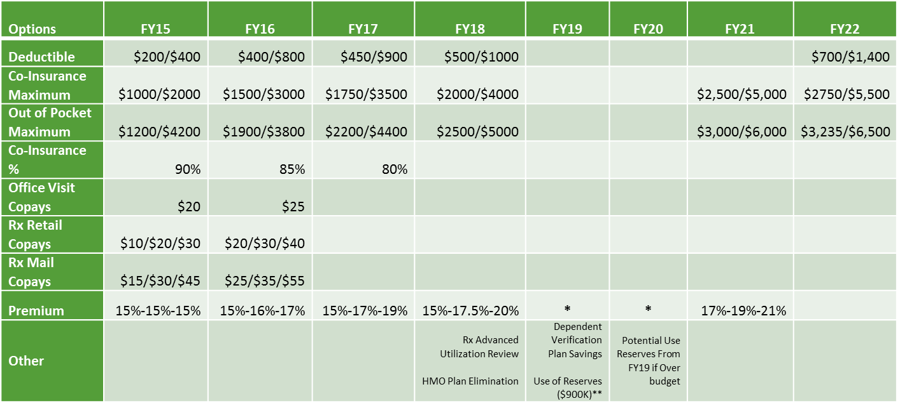
BAC Recommendations
*In years where the percent of premiums paid by employees does not change, premiums still increase as they are tied to the annual expected increase in health care costs.
** Planned use of reserves in FY19 was not needed.

Slide 47
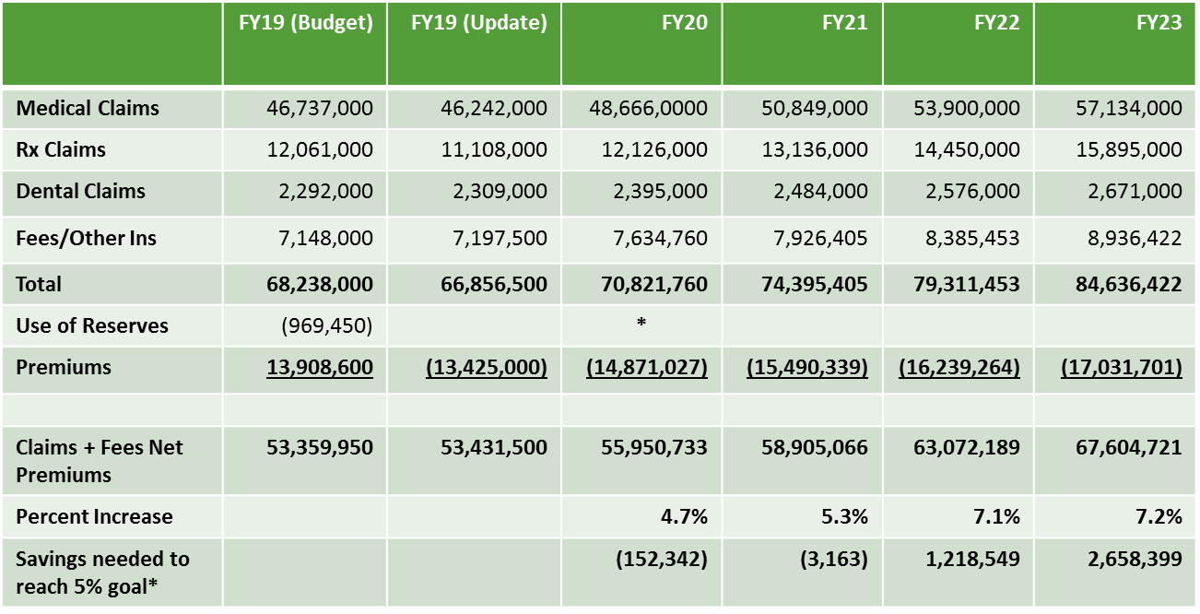
Budget Projections and Cost Savings Needed to Maintain 5% Goal
* Use of reserves for FY20 only if over budget

Slide 48
BAC Discussions for FY20+
USI consulting relationship (new cost projections, new data warehouse and reporting, etc.)
IUC RFP for life, disability, and dental insurance plans.
  RFP process is underway. Each university decides whether to contract with RFP finalist. Impact for Ohio University contracts would be July 1, 2020.
USI likely to conduct RFP for Express Scripts and/or Anthem Contract for July 1, 2020 Effective Date
  Last full RFP was conducted in 2009-10
Long term road map for benefits
  Attempt to move from premium/cost sharing changes to other options
    High Deductible Health with Health Savings Accounts
    Targeted care management programs
    Narrow provider network
    Cost/Quality transparency tools
    Etc.
Impact of Affordable Care Act Cadillac Plan Tax on Faculty/Staff plan and AFSCME plan
  Possibility of combining plans and subsequent impact

Slide 49
Benefits Advisory Council Background Information
BAC formed in March 2014
Charge: Analyze and make recommendations regarding university benefits and to consider financial sustainability, competitiveness, and fairness in recommendations.
14 Members include representatives from Faculty Senate (Co Chair), Administrative Senate, Classified Senate, AFSCME Union, as well as a Dean, an Executive Dean, a Vice President, an Academic Chair/Director, an Associate Provost, and the Chief HR Officer

Slide 50
Benefits Advisory Council Background Information
Guiding Principles
  Eliminate structural deficits
  Avoid Affordable Care Act Cadillac Plan Tax (required by state law)
  Establish a maximum university contribution to the annual inflationary cost of benefits (no more than 5%)
Previous Recommendations have included a mix of
  Premium increases: All employees pay more
  Cost-Sharing Increases: Users of the plan pay more
  Consumerism (Rx Advanced Utilization Review): Influence “smarter” utilization
  Wellness: Supporting wellness via HealthyOhio rewards and web based wellness platform, Wellworks 100 visit incentive, sponsor CHIP program, etc.
Previous recommendations include (but not limited to):
  Three year (FY16, FY17, FY18) plan to mitigate costs (5% goal) and avoid Cadillac plan tax included increases in deductibles, copays, out of pocket maximum and etc.
  Increase the percent of premiums paid by employees
  Changing benefits eligibility or staff to positions with an FTE of 0.75 or greater and appointment length of 4 months or longer (included grandfathering)
  Offer new vision and short term disability plans
  Ensure benefit plans provide coverage for transgender health care needs
  Funding for HealthyOhio, specifically the VirginPulse wellness program web site
  Adding Advanced Utilization Management Programs for Prescription Drug Plan
    Prior Authorization, Step Therapy, etc. in addition to exclusive home deliver and generics preferred program
  Elimination of HMO plan for Eastern Campus Employees
  Conduct Dependent Eligibility Audit

Slide 51
Benefits Open Enrollment
Scheduled for April 15 – May 8
  System will be active the afternoon of April 15
  Emails will be sent to faculty and staff as the system is activated
Annual period during which you can make changes to benefit elections.
  Changes are effective July 1, 2019
Faculty and Staff PPO premiums are increasing by approximately 6%. Dental premiums increase slightly as well. No other major changes to benefit plans.
Passive enrollment for all benefits excepting flexible spending accounts
  Must enroll in a flexible spending account each year
  Other benefit elections will remain as-is if you take no action
Use My Personal Information – Self Service Benefits to enroll and make changes
  Access and assistance available in the HR lobby. Open labs will be scheduled as well.
The open forum and presentation schedule will be emailed to faculty and by April 15

Slide 52
OHIO Ready Staff Program Update
Mindy Colburn, Assistant Director, VPFA Business Service Center

Slide 53
Purpose/Mission
Create a cost effective pool of employees who can fill short term OU accounting/office staffing needs to limit downtime for departments
Cover internal leaves (medical, maternity, paternity, disciplinary) and departmental “busy seasons”
Backfill vacancies temporarily during posting and recruiting processes
Create a pipeline of talent for the university

Slide 54
Staffing Update
We currently have 6 full-time Accounting Support Associates
The staffing strategy goal was to have a broad representation of units. Units served since program inception:
VP University Finance President’s Office Alden Library
Linguistics/ELIP Allen Center Kids on Campus
HCOM College Health Sciences & Professions College of Fine Arts
College of Arts and Sciences Russ College of Engineering Scripps College
College of Business Architecture Design & Construction Real Estate
Procurement Legal Affairs General Accounting
Printing Services Culinary Services Accounts Payable
Transportation Services Global Affairs & International Studies University Advancement

Slide 55
Cohort timeline
10/31/2016 1st Cohort 3 employees
4/16/2017 2nd Cohort 3 employees
10/9/2017 3rd Cohort 2 employees
10/15/2018 4th Cohort 2 employees
3/4/2019 5th Cohort 4 employees
Total of 14 employees hired with 8 moving on to promotional opportunities within the University (HCOM, Event Services, College of Health Sciences, Printing Services, College of Arts & Sciences, College of Engineering, Accounts Payable, VPFA Business Service Center)

Slide 56
Funding Model
OHIO Ready Staff functions as a full cost recovery department
Departments are only billed for the hours worked in their respective area
PTO, training, departmental meetings, office expenses, etc. are included in the cost recovery model; Training and program oversight is absorbed by the VPFA Business Service Center
Financial Update:
  FY17 $17,935 loss (due to program start-up expenses)
  FY18 $12,828 profit (balance back to university)
  FY19 projected break-even
90% overall utilization rate since inception

Slide 57
Notes, Observations and Feedback
Higher than expected demand for part-time assignments and longer term assignments
Not enough staff to fulfill all staffing requests
Positive Feedback from Classified Senate, Employee Resource Fair and Vendor Fair
Very good feedback from units regarding the quality of work, the ease of transition and the knowledge base of employees when arriving on site for assignments
  “Great job, very professional.”
  “We’ve been pleased and they’ve both been a great asset to us. They both engendered a high level of trust in a very short period of time.”
  “This is a great program and I would highly recommend it to others.”
  “Huge help in moving this project forward.”
  “She has completed all task thoroughly and has done a wonderful job.”
  “She did a very good job keeping her composure when she had to cover both buying centers by herself.”

Slide 58
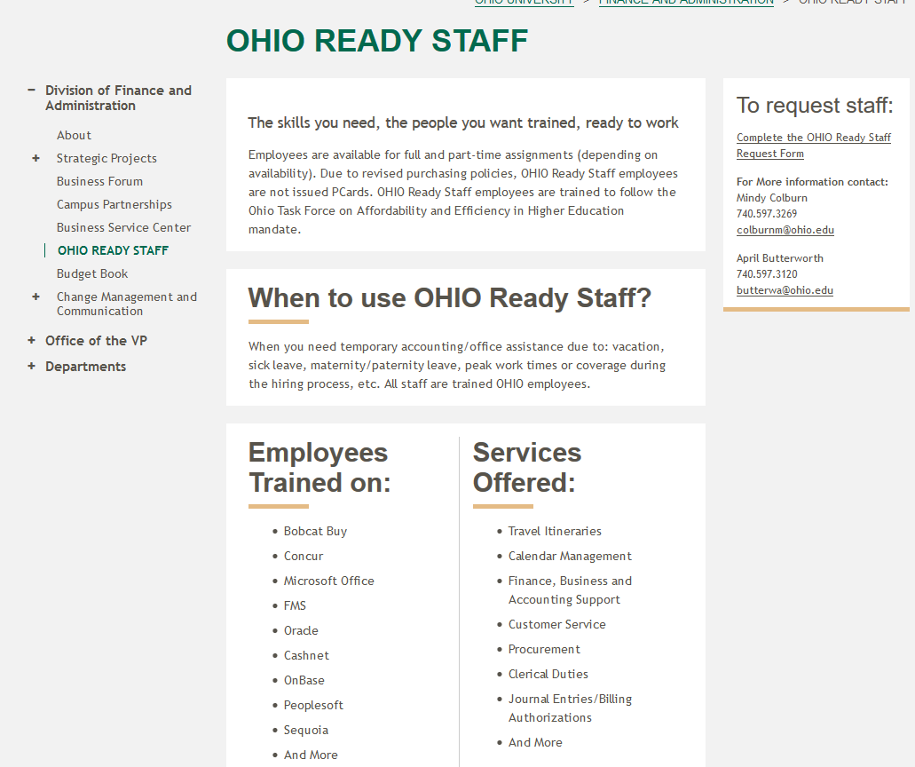
OHIO.EDU/OHIO-READY-STAFF

Slide 59
Questions and Inquiries
Mindy Colburn, Assistant Director, VPFA Business Service Center/OHIO Ready Staff
740-597-3269 or colburnm@ohio.edu

Slide 60
Next Business Forum
Thursday, June 6
9-11 AM
HRTC 141-45

