Slide 1


PROCESS TRAINING

Slide 2

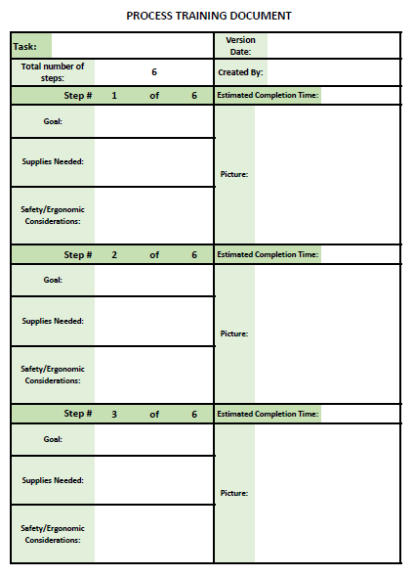
PURPOSE
A template for establishing a standardized procedure for a task
Keep at the task site
Used for teaching new employees and as a reference while working

Slide 3
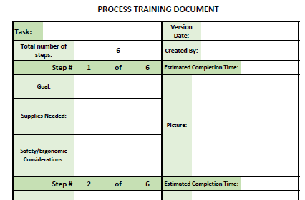
INSTRUCTIONS
Version date is important to ensure the newest process is being used at all times
Task should be clearly identified
Task should be broken down into steps (six is the default number of steps but can be changed to fit the specific task)
Created by should show the team or employee responsible for filling out the document

Slide 4
INSTRUCTIONS
Each step should include:
  Goal- what will be accomplished at the end of that step
  Supplies needed- all things needed to complete this step (tools, parts, and safety equipment etc.)
  Safety/ergonomic concerns that workers should be aware of
  Picture of the process

Slide 5
INSTRUCTIONS
  Each step should also include an estimated completion time.
    Can be a range
    Used to standardize the process and keep the workers on a comfortable but steady production pace

