Slide 1


INSTRUCTIONS FOR NARRATION
To hear the narration:
  Make sure your volume is turned up
  On toolbar, selected Slide Show make sure ‘Play Narrations’ and ‘Use Timings’ is clicked
  Under the same toolbar heading, choose either play ‘From Beginning’ or ‘From Current Slide’
  Slides will advance automatically

Slide 2



Process Map

Slide 3
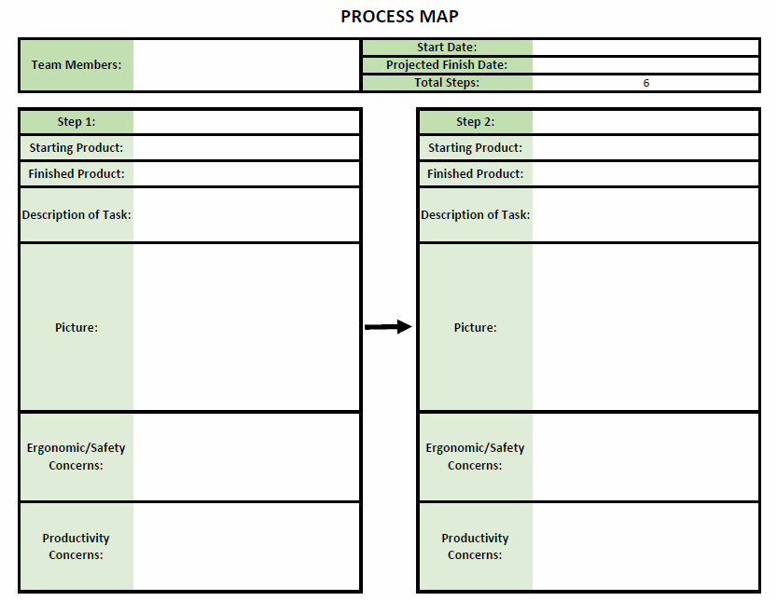
PURPOSE
Bring together employees who complete different aspects of the entire process.
Expand their understanding of the entire process and collaborate to make overall improvements to safety and/or production.

Slide 4
HEADER
  Should include:
    All team members working on the tool
    Start date
    Finish date
    Number of steps to complete the entire process

Slide 5
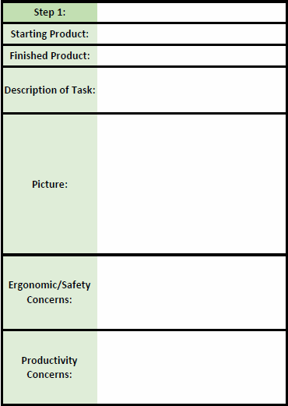
EACH STEP BLOCK
  Should be a complete block for each step in the process
  Will include:
    Starting product (i.e. raw material)
    What product leaves that station
    A brief description of the task (what is done to transform the product)
    Picture
    Any ergonomic or safety concerns
    Any productivity concerns

Slide 6

OPPORTUNITIES TO IMPROVE
  From discussion, opportunities to improve ergonomics/safety and/or production should be assessed.
  For example, the employees at step 1 may be able to make a minor change in their process that drastically improves the safety risks at step 5.
  By looking at the process in a holistic manner, the team may be able to make incremental changes to improve the overall process.

Slide 7
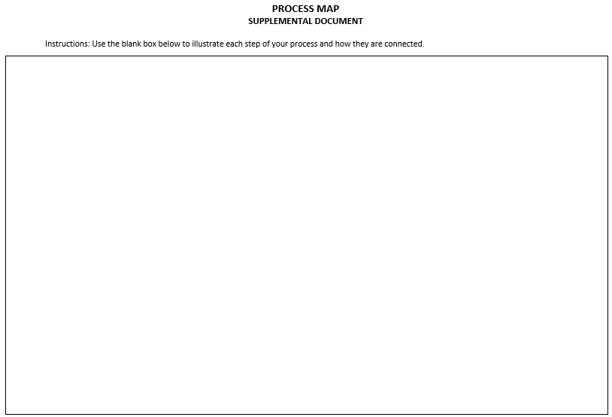
SUPPLEMENTAL DOCUMENT
Used in addition to the main process map
Word document, used to illustrate the process and diagram the flow of the material
Can also be done on any tools the company has (i.e. white board or jumbo note pad).

