Slide 1


Prioritization Tool

Slide 2


Purpose
A facility or process may have many areas that need improvements and it may seem overwhelming
Thus, priorities need to be set to determine which problems to tackle first
Goal → Prioritize problems based on ergonomic, safety, and productivity risks
Once problems are prioritized, actions can be taken and monitored in a strategic way
Prevent this feeling!

Slide 3
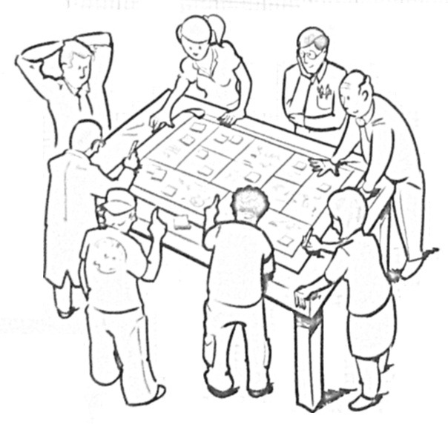
Instructions
This tool is best filled out by a team of individuals with a wide knowledge of the areas and processes
This allows for as many problems as possible to be considered
Also this document should be used to monitor the priority of problems as corrective actions are taken over time

Slide 4
Headers
At the top fill in
Team Members
Date
Then 3 steps for each problem
Characterize the Problem
Action Plan
Results

Slide 5
Step 1: Characterize the Problem
Enter the department in which a problem occurs
Helps identify high priority departments
Enter a unique name for the problem
Enter any potential injuries or ergonomic risks associated with the problem
Then assign these risk a severity ranking (1-3)
(1 = Low Risk, 2=Moderate Risk, 3=Severe Risk)

Slide 6
Step 1: Characterize the Problem
Here is a guide for assigning the severity of ergonomic and safety risks
Ranking | Examples
1 – mild | Observation is good No observable safety/ergonomic risk
2 - moderate | Near misses Minor incidents Observation of a likelihood that an injury or ergonomic issue may occur
3 - severe | Already had an injury as a result of this problem Task frequently leads to musculoskeletal disorders

Slide 7
Step 1: Characterize the Problem (continued)
Enter any potential productivity risks in the same way in the column “SEV 2”
Ranking | Examples
1 – mild | Observation is good No observable productivity risk
2 - moderate | Minor delays A lot of variability in the process Observation of a likelihood that a productivity issue may occur
3 - severe | Already had a major productivity incident Serious delay High occurrence of rework

Slide 8
Note on Ranking System for Severity
Based on the scores assigned, the Excel sheet will calculate a priority color as shown below

Slide 9
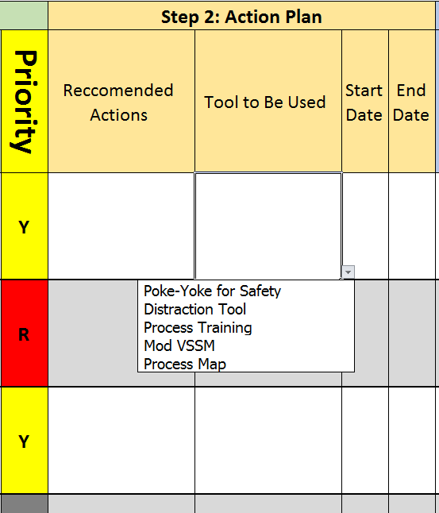
Step 2: Create an Action Plan
From Priorities in Step 1, select a problem to create an action plan for
Enter recommended actions for that row
Consider using another BWC tool from the drop down box to help tackle the problem
Enter a start and end date

Slide 10
Step 3: Monitor Results, Adjust Priorities
List the actions taken to the problem in each row
Assign new severity numbers from 1-3
SEV 1: Safety and Ergonomic Risks
SEV 2: Productivity Risks
The new severity numbers will be used to calculate a new priority/color
Hopefully it will go down from step 1!
A new project can be selected by reviewing the priorities

