Slide 1


INSTRUCTIONS FOR NARRATOIN
To hear the narration:
  Make sure your volume is turned up
  On toolbar, selected Slide Show make sure ‘Play Narrations’ and ‘Use Timings’ is clicked
  Under the same toolbar heading, choose either play ‘From Beginning’ or ‘From Current Slide’
  Slides will advance automatically

Slide 2



Poke-Yoke for Safety Requirements

Slide 3
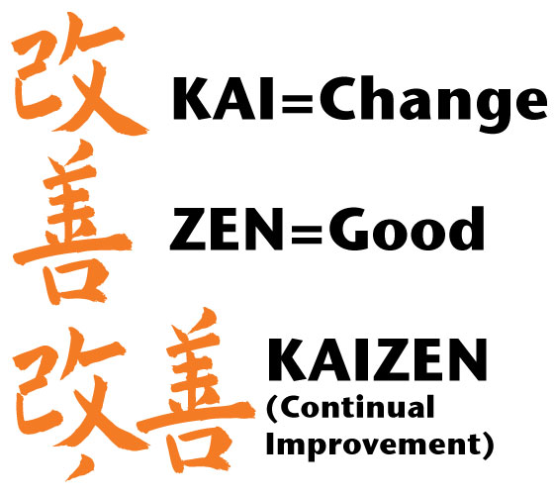
PURPOSE
Kaizen events can be used as a workplace intervention to improve both productivity and safety
Often times when completing a 6S, the improvement team focuses on the reorganization to improve productivity and safety regulations can take a back seat
This PowerPoint is a quick refresher on common safety regulations and hazards to keep in mind when completing a Kaizen event

Slide 4
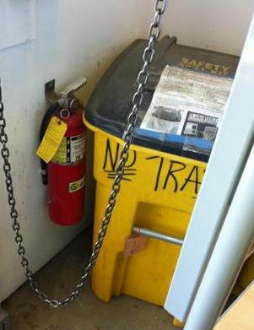



FIRE EXTINGUISHERS
There is a 36” clearance around each fire extinguisher.

Slide 5
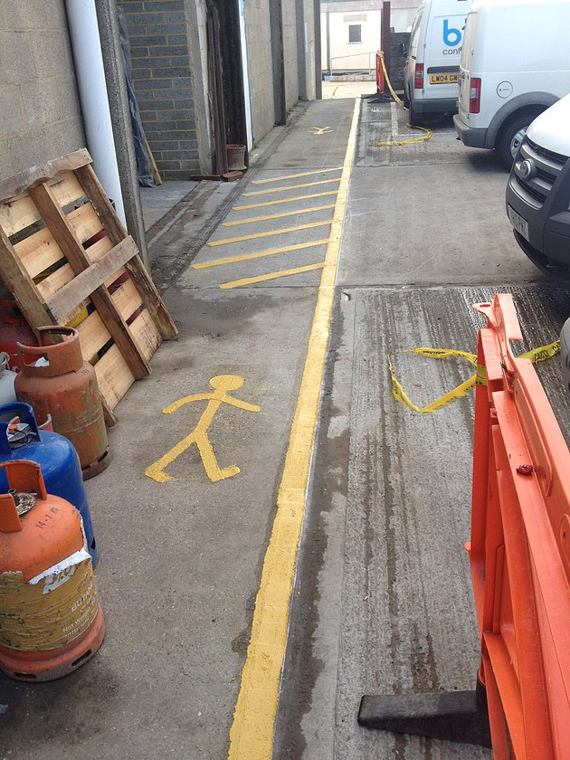
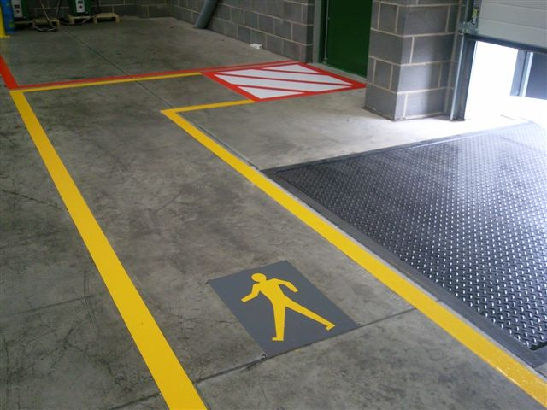
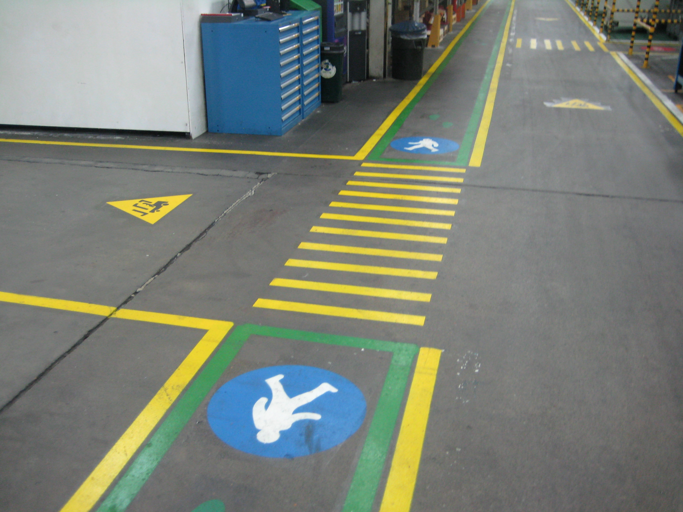
WALKWAYS/EMERGENCY EXITS
Walkways and emergency exit(s) are accessible and workers know the appropriate route.

Slide 6
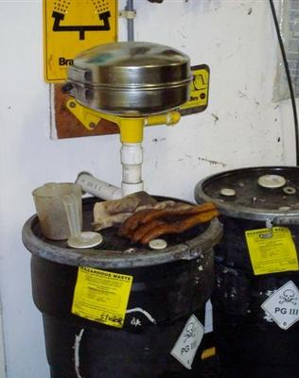
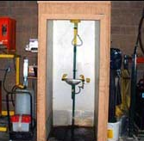
EYEWASH STATIONS
There is a 36” clearance around each eyewash station.

Slide 7
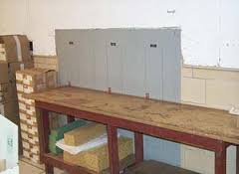
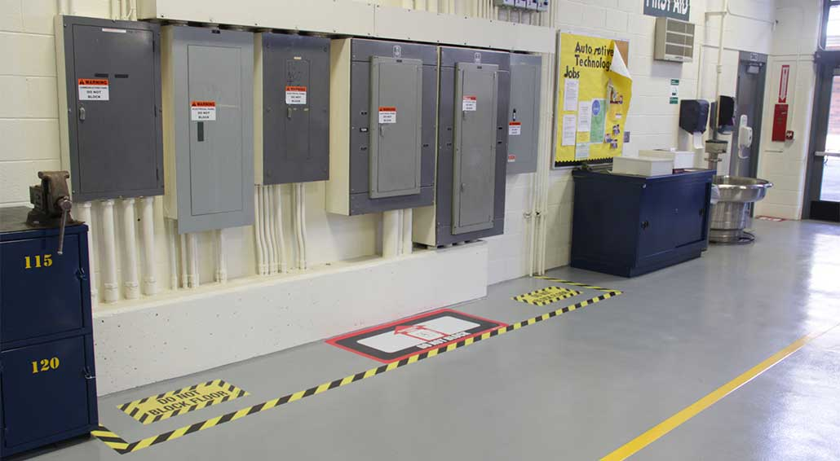
ELECTRICAL PANELS
The front of electrical panels has a minimum of three feet of clearance and a minimum width to be the width of the equipment or 2.5 feet, whichever is greater.

Slide 8
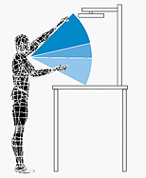

AIR SHUT OFF VALVE
Air shut off point is within reasonable distance for employees: (tables should allow enough space if back to back and must not be too tall)

Slide 9

PHONE/EMERGENCY LIST
There is a phone within reasonable distance from the workstation to be accessed for paging.
The emergency phone list is located near the phone.

Slide 10


FORKLIFT TRAFFIC
Employees and/or equipment does not interfere with forklift traffic.
Blind corners are equipped with mirrors and/or warning signs.

Slide 11
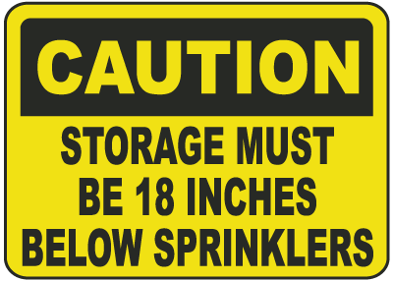
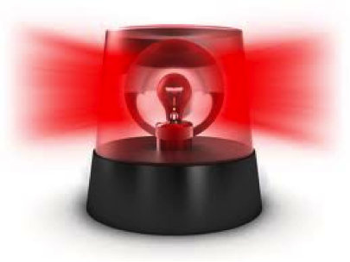
FIRE SPRINKLER/SPEAKERS
  All fire sprinkler heads have at least an 18” clearance below.
  Employees in the workstation are able to hear the speakers/horns (add or relocate speakers if necessary)

Slide 12
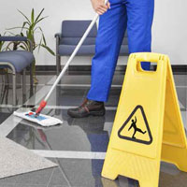
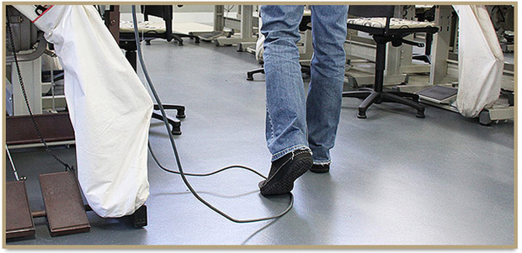
FLOORING/TRIP HAZARDS
All floors are clean, dry, and slip resistant.
Air hose lines and electrical cords are not a trip hazard.

Slide 13
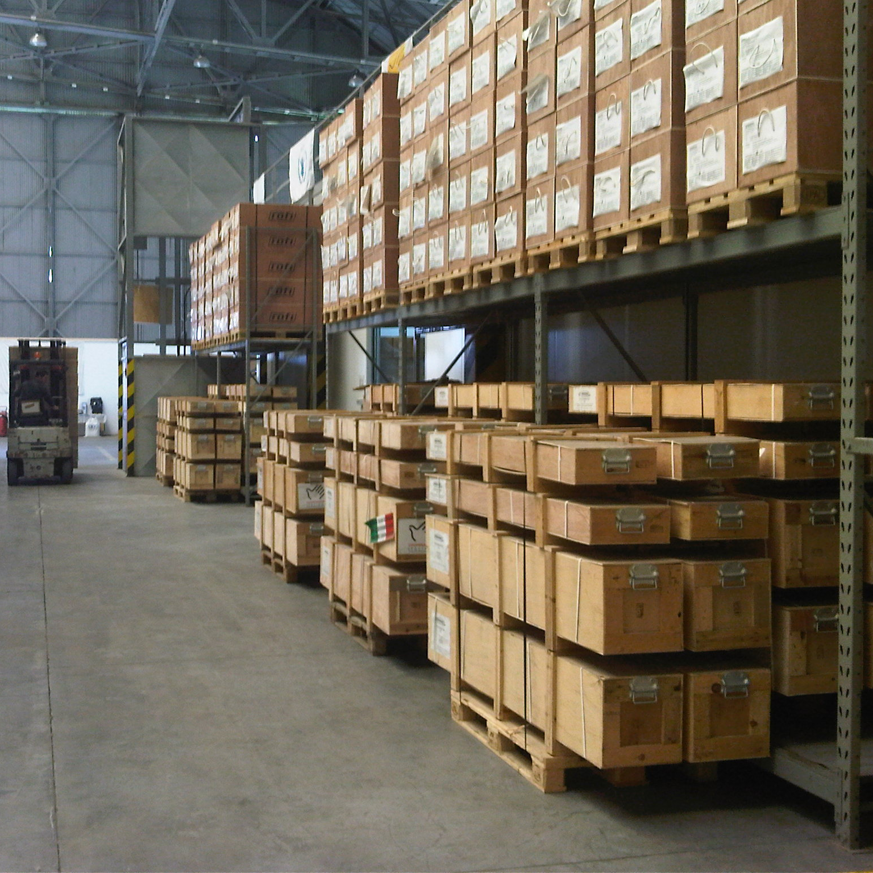
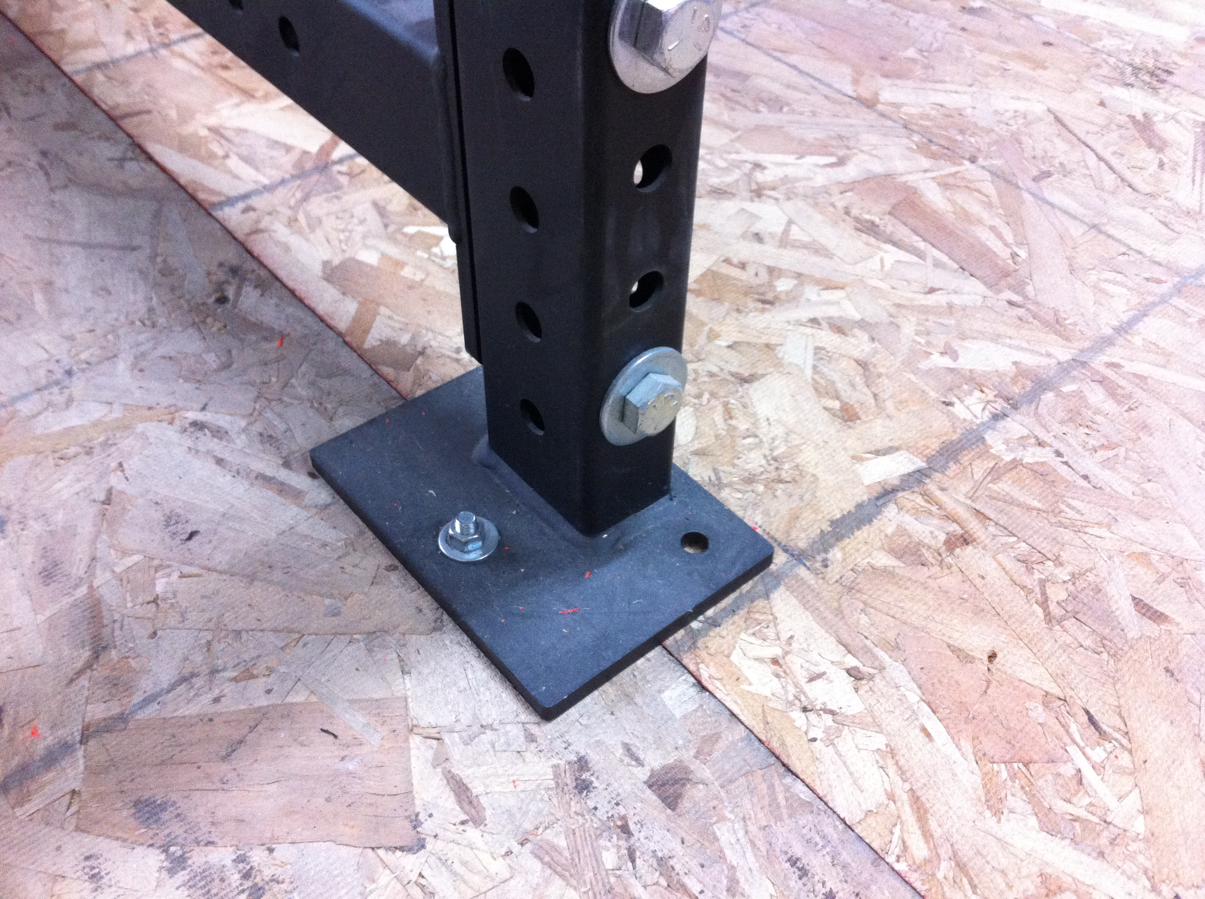
STORAGE/LIGHTING
All storage racks are bolted down to ensure stability.
Site is properly lit

