Slide 1


Modular Value Stream Safety Map (MOD VSSM)

Slide 2

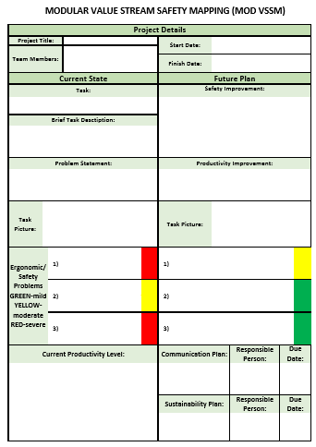
PURPOSE
Mod VSSM is designed to look at a specific part of a longer process.
Difference from traditional VSM:
Allows the team to identify more specific problems in a task that may be otherwise be overlooked
Inclusion of ergonomic/safety problems of the work task

Slide 3
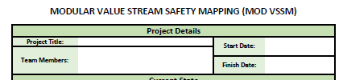
PROJECT DETAILS
Project Details
An identifier for the project
Specific team members
Keep a record for timing of the project

Slide 4
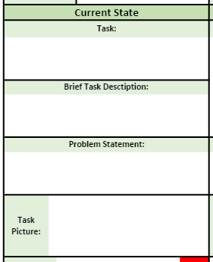
CURRENT STATE
Current State
Describe the task and how it currently operates
Problem statement should describe:
What is wrong with the task
The focus of the intervention
Task Picture to show the current set-up

Slide 5
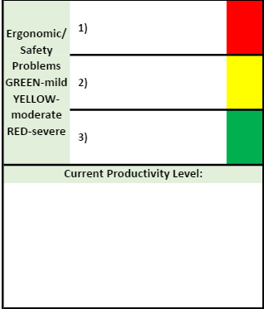
CURRENT STATE
Ergonomic/safety concerns of the current process
- Each one should be color coded for the severity
Green is mild- limited concern
Yellow- moderate concern, should be improved through this process
Red- severe concern, needs to be improved immediately
Below, document the current productivity level and how safety and production are affected by one another in the current task.

Slide 6
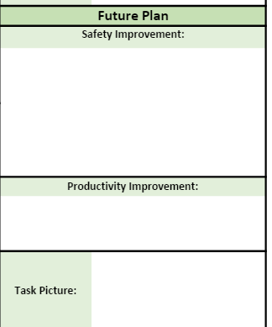
FUTURE PLAN
Future Plan
To be completed after changes for the current task have been discussed and a plan to implement them has been developed.
Safety Improvements
Include at least some of the concerns addressed in the current state section and how they will be improved
Productivity Improvement
Relate to the previous production level and clearly identify how it will be affected by the changes
Task Picture of the improved task set-up

Slide 7
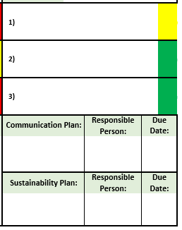
FUTURE PLAN
Ergonomic/safety improvement
- Should include at least some of the concerns addressed in the current state section and how they will be improved.
- As before, each one should be color coded for the severity
Communication Plan
- How employees will be informed of the change
Any documents needed to be created or altered to include the updated task
Document who will be responsible for carrying out the communication plan and when it should be completed by
Sustainability Plan
How the process will be reviewed to ensure it is still operating with the new changes
Could include but it not limited to an audit schedule or updated training documents
Document who will be responsible for carrying out the sustainability plan and when it should be completed by

